Slide 1
PYTHON PROGRAMMING
22-08-2023
Krunal Kshirsagar

Slide 2
Agenda
What is Python? And Why Python?
Setting Up Python
Variables
Data Types
Demo

Slide 3

What is Python?
Python is a high-level, interpreted programming language
What is interpreted?
Python's interpreter reads the source code and executes it directly
Interpretation happens line by line during runtime
There's no separate compilation step

Slide 4
Easy to Learn/Write
Versatility
Open Source
Object Oriented
Dynamically typed language
Simplified syntax
Vast libraries

Slide 5
How Do You Install Python?
Give answers in the chatbox, please!

Slide 6
What is variables?
Variables are names that represent memory locations to store data in a program.
They allow us to manipulate and work with data easily.

Slide 7
What is print()
How to create new line?
Difference between string, number printing
- To prints something
\n
Print(“Krunal”)
Print(123)

Slide 8
What are types of VARIABLES?
Local Variables
Global Variables
Instance Variables
Defined inside a function and have limited scope
Defined outside functions and can be accessed throughout the program.
Belong to specific instances of a class (used in object-oriented programming)

Slide 9
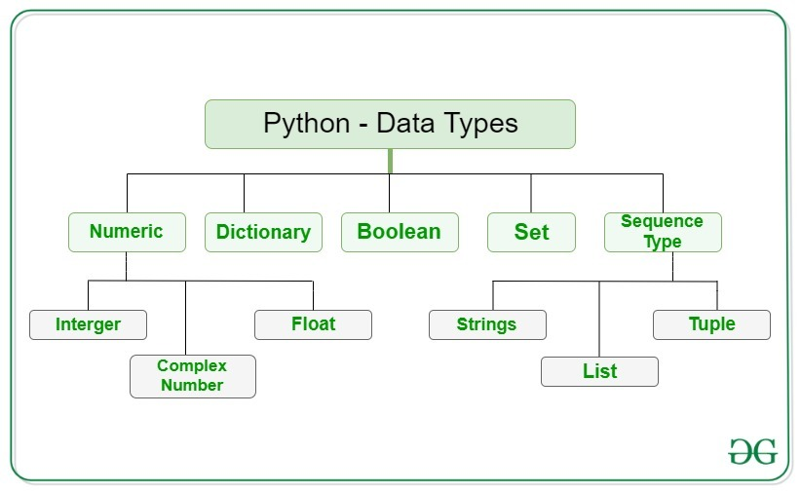
What are different data types in python?

Slide 10
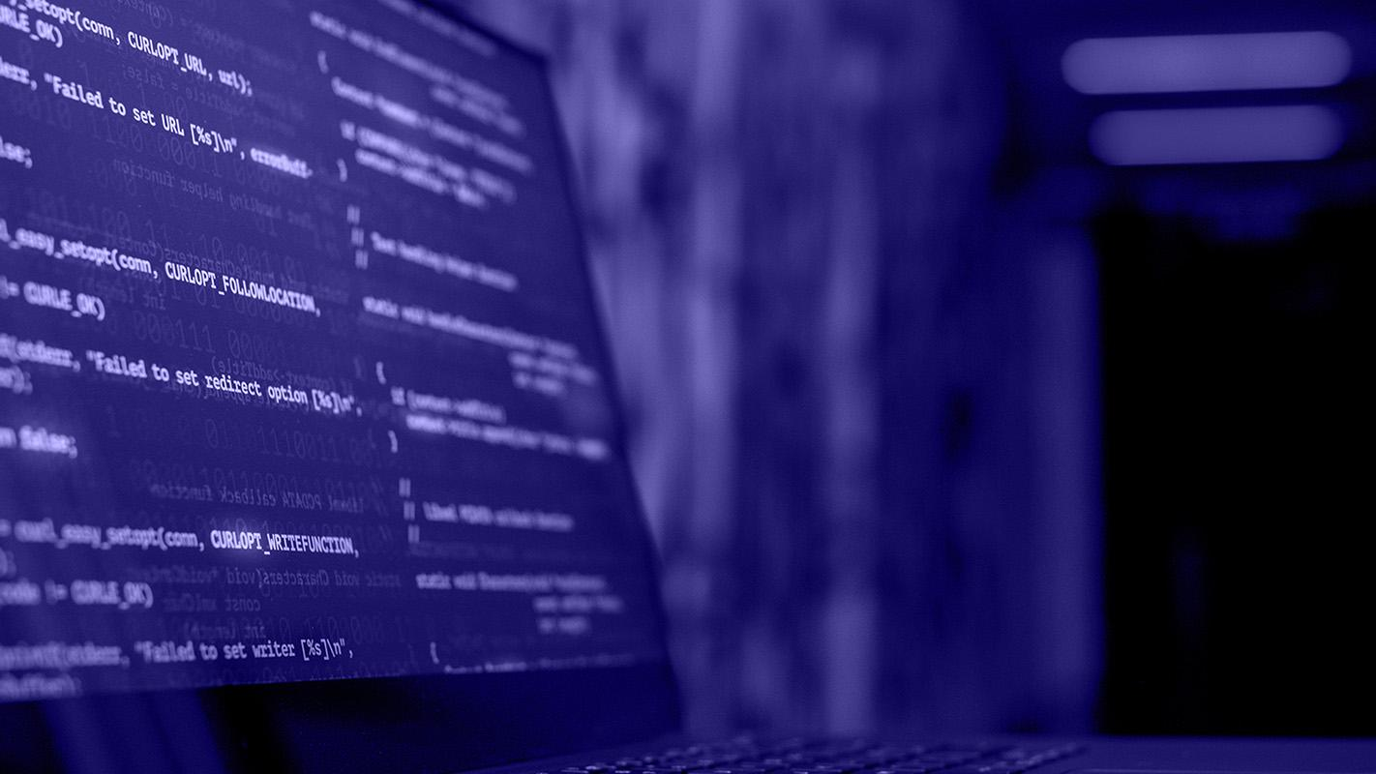
What is type conversion? You can convert between data types using functions like int(), float(), and str() e.g., num_int = int(num_str)

Slide 11
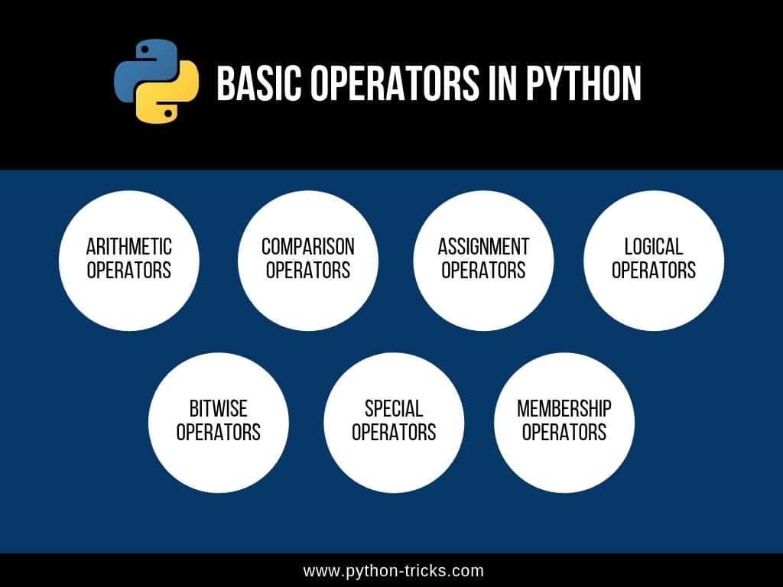
What are basic operators in python?

Slide 12
DEMO

